Slide 1
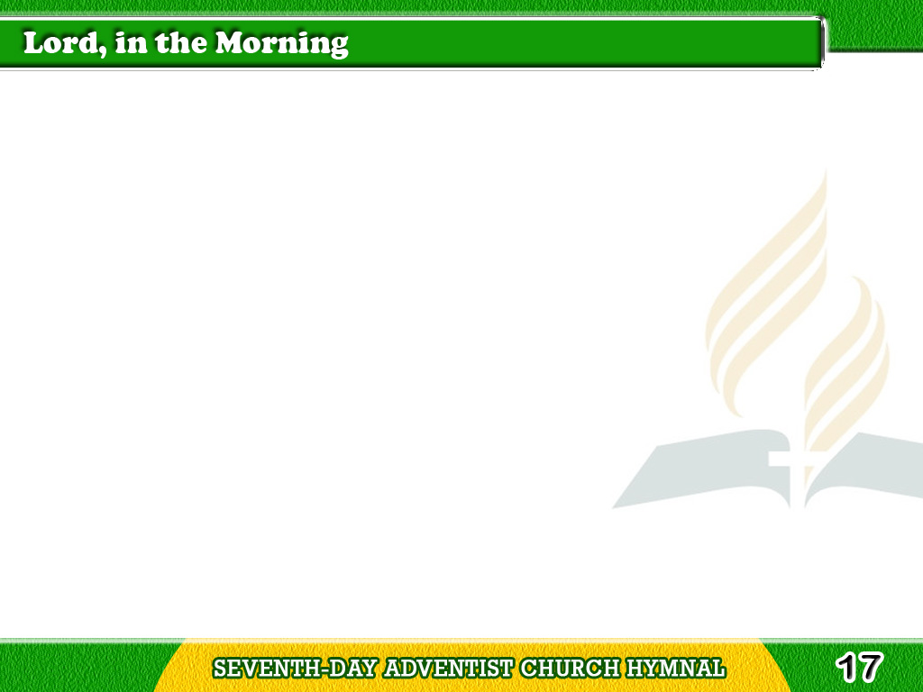
1/4
Lord, in the morning
Thou shalt hear
My voice ascending high;
Tagalog
Version

Slide 2
1/4
To Thee will I direct
my prayer,
To Thee lift up mine eye
Tagalog
Version

Slide 3
2/4
Up to the hills where
Christ is gone
To plead for all His saints,
Tagalog
Version

Slide 4
2/4
Presenting at His
Father’s throne
Our songs and our complaints.
Tagalog
Version

Slide 5
3/4
O may Thy Spirit
guide my feet
In ways of righteousness;
Tagalog
Version

Slide 6
3/4
Make every path of
duty straight
And plain before my face.
Tagalog
Version

Slide 7
4/4
The men that love and
fear Thy name
Shall see their hopes fulfilled;
Tagalog
Version

Slide 8
4/4
The mighty God will
compass them
With favor as a shield.
Tagalog
Version

